Slide 1
Used car price prediction model
Submitted by:
Akash

Slide 2
Table of contents
Data scraping
Making dataframe
Data cleaning
Data preprocessing
Data visualization
Model training
Predicting the car price

Slide 3
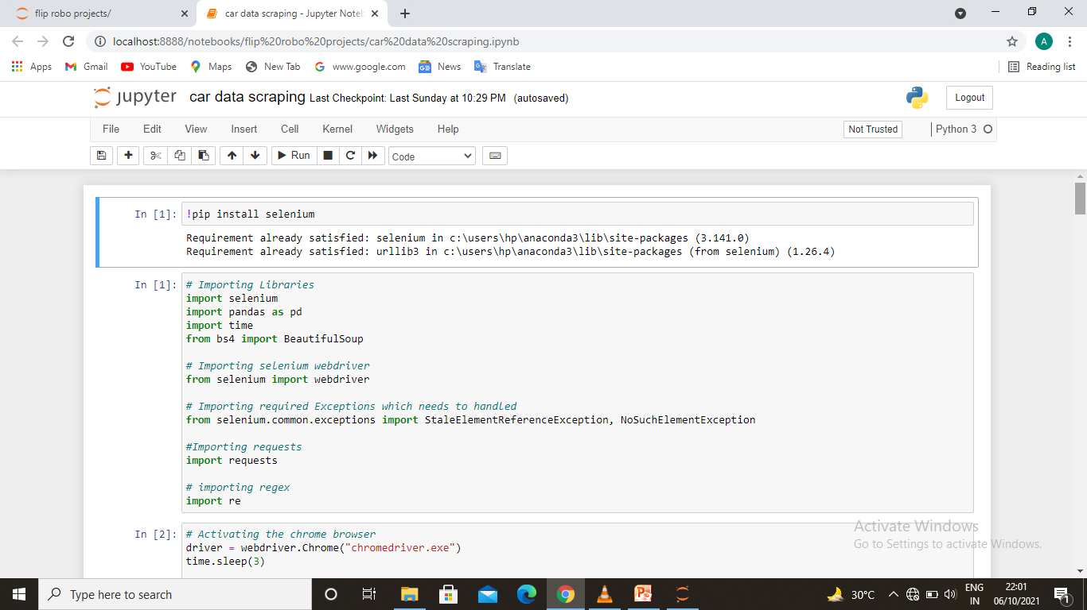
Data scraping used libraries

Slide 4
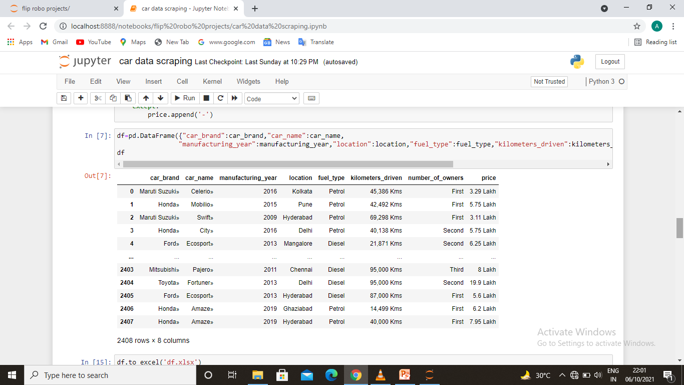
Making the data frame

Slide 5
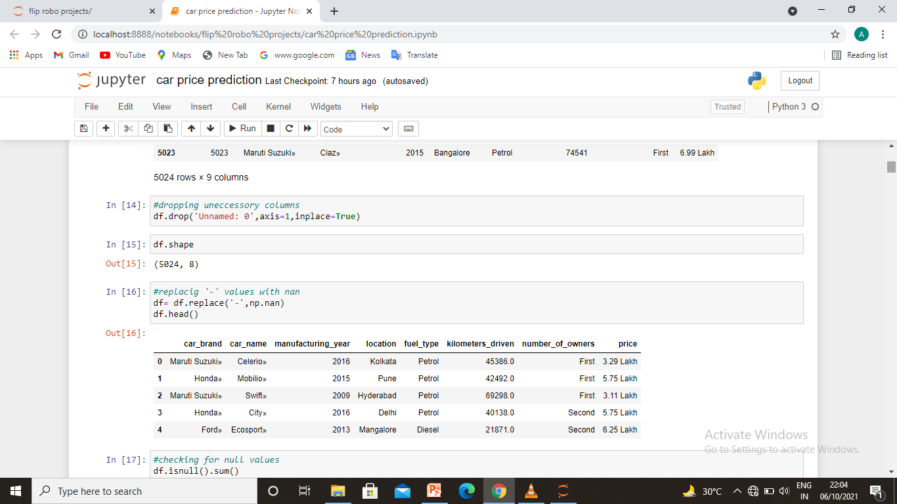
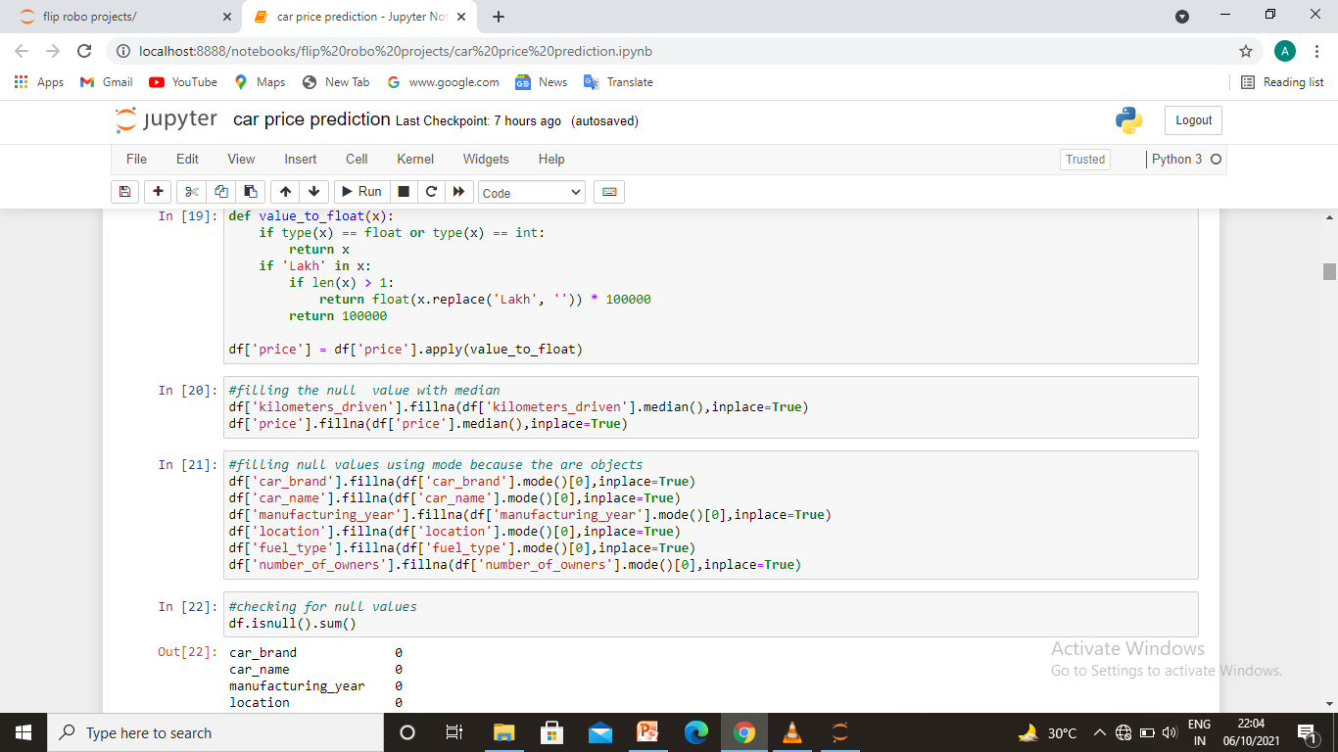
Data cleaning

Slide 6
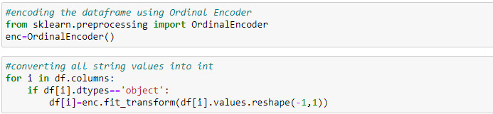
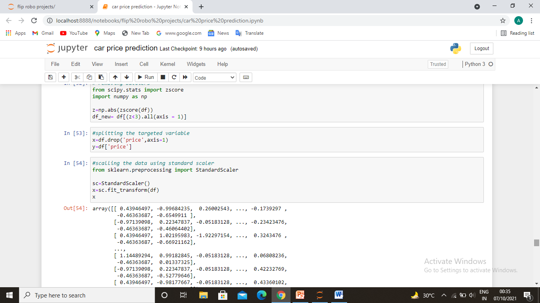
Data preprocessing
First of all we got data the data in excel form so we import this into our model. we need to clean up the data although its almost cleaned because we have gathered it by ourselves so we just added only those columns which we need the most so first we need to clean the data in the data there are 5024 rows and 9 columns inclusive of nan values and an unnamed column which comes by default. So we decide to drop the unnamed numeric column than fill rest of null values with different mean and mode technique. To clean the data. Than we correlate the targeted variable with some important independent variables.

Slide 7
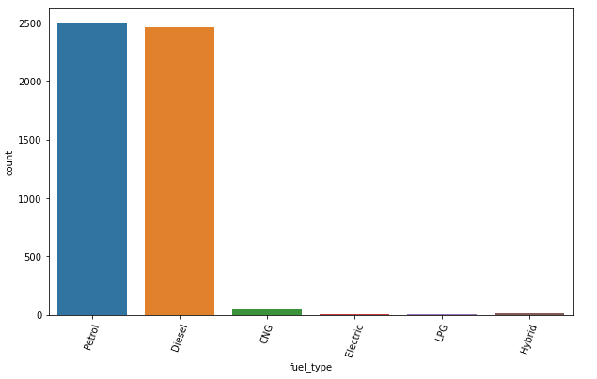
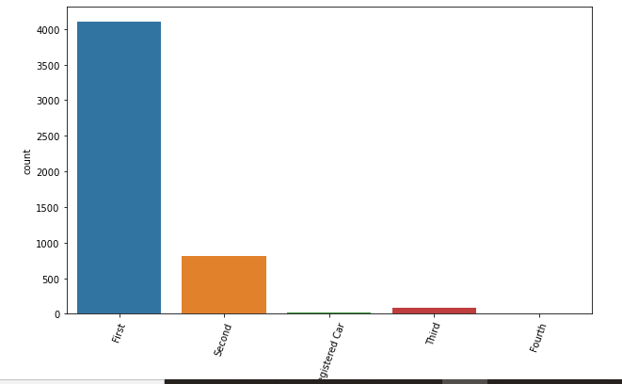
Data visualisation
Visualization of all the variables
Car brand
Car name
Manufacturing year
Number of owners
Fuel type
City

Slide 8
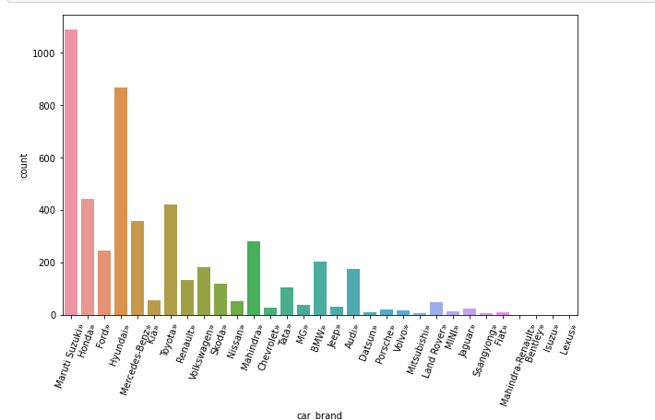
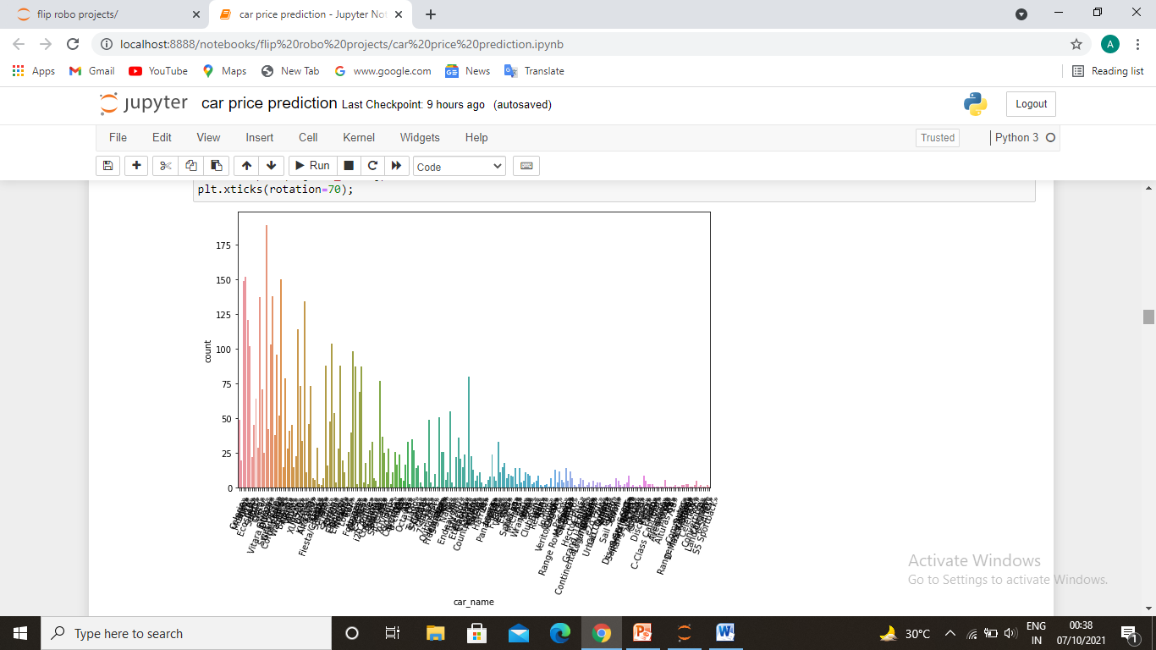
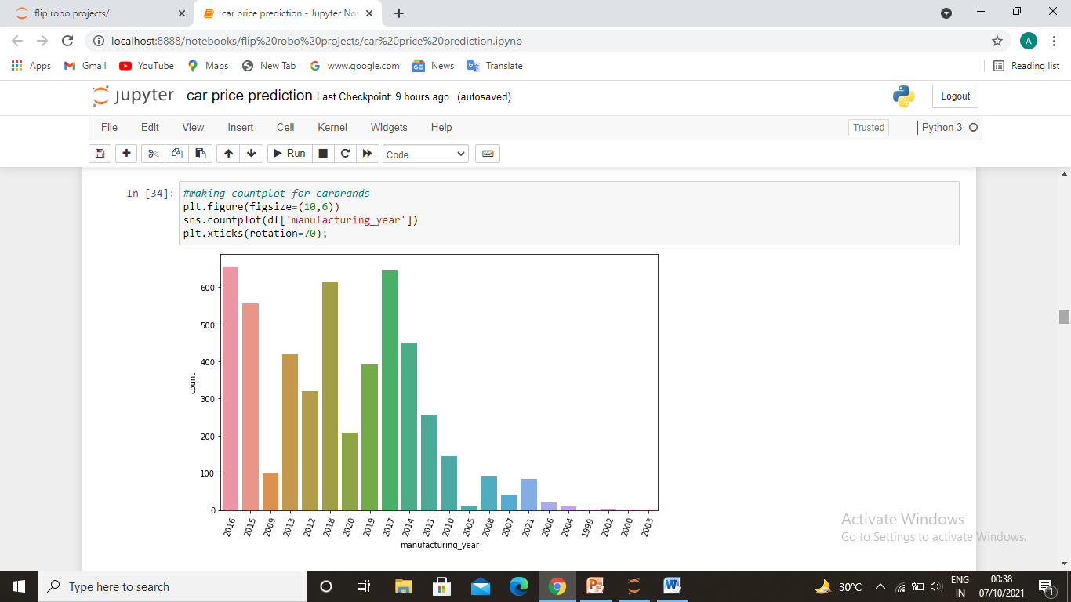
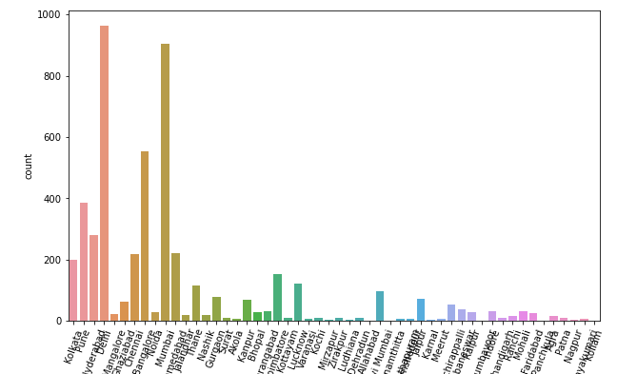
Data visualization

Slide 9
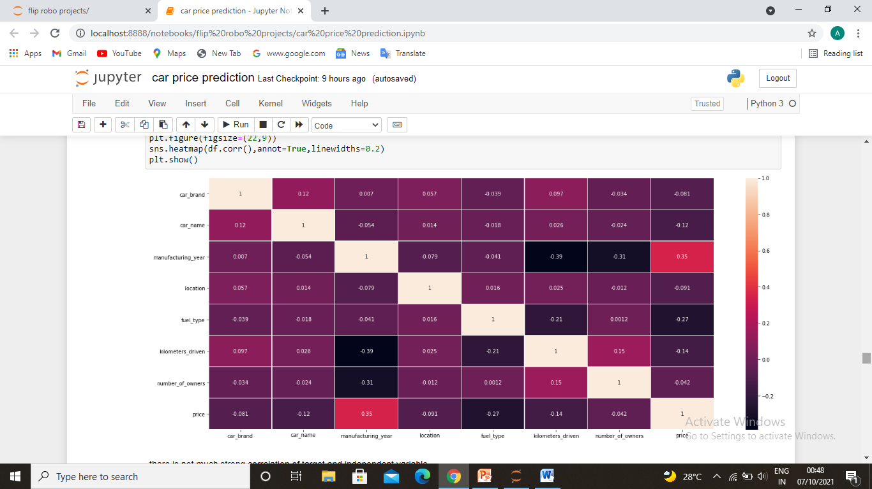
Correlation of targeted and independent variale

Slide 10
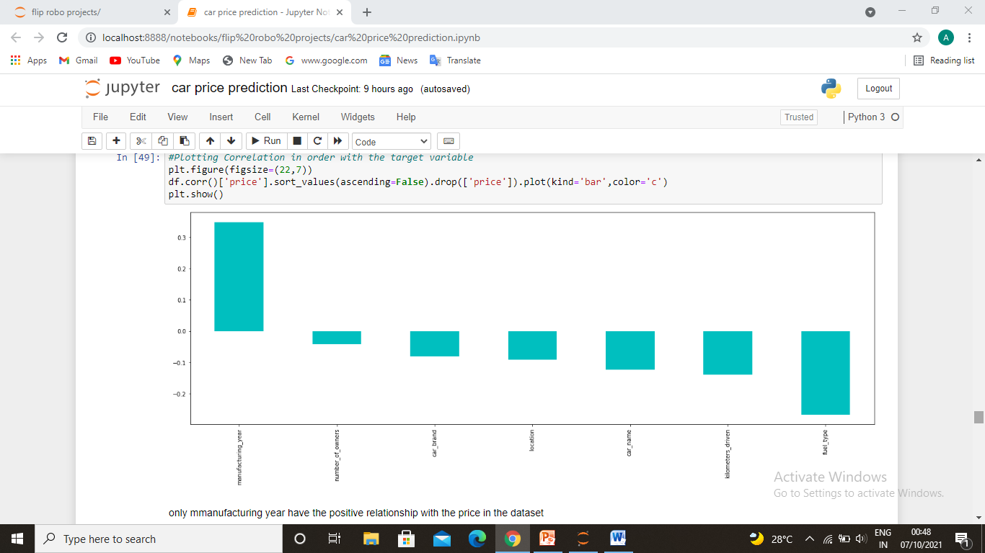
Correlation with target
there is not much strong correlation of target and independent variable
even some variables have negative correlation
only manufacturing year have the positive relationship with the price in the dataset

Slide 11
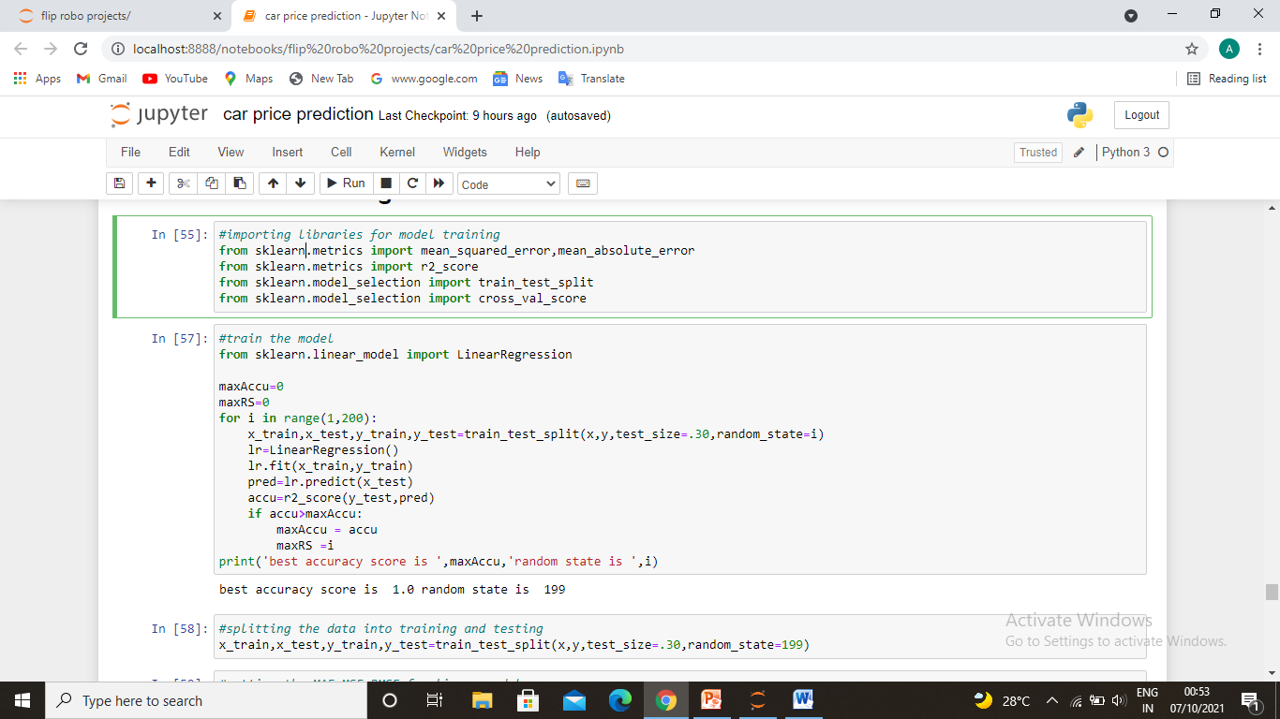
Train the model
First importing libraries
Train the model

Slide 12
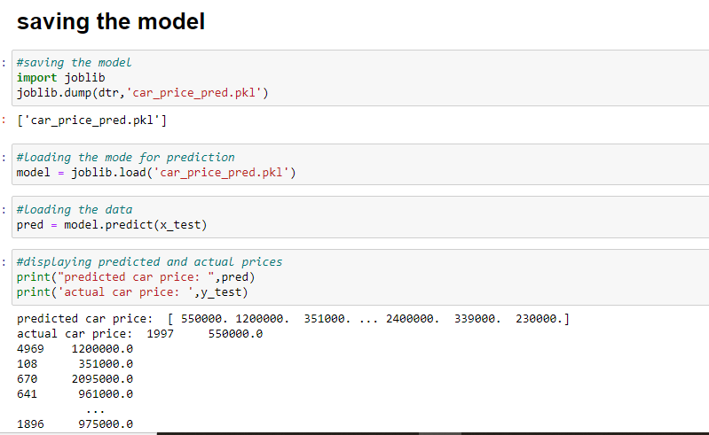
Predicting the car prices
Predicting the car prices after saving the best model.

